Slide 1
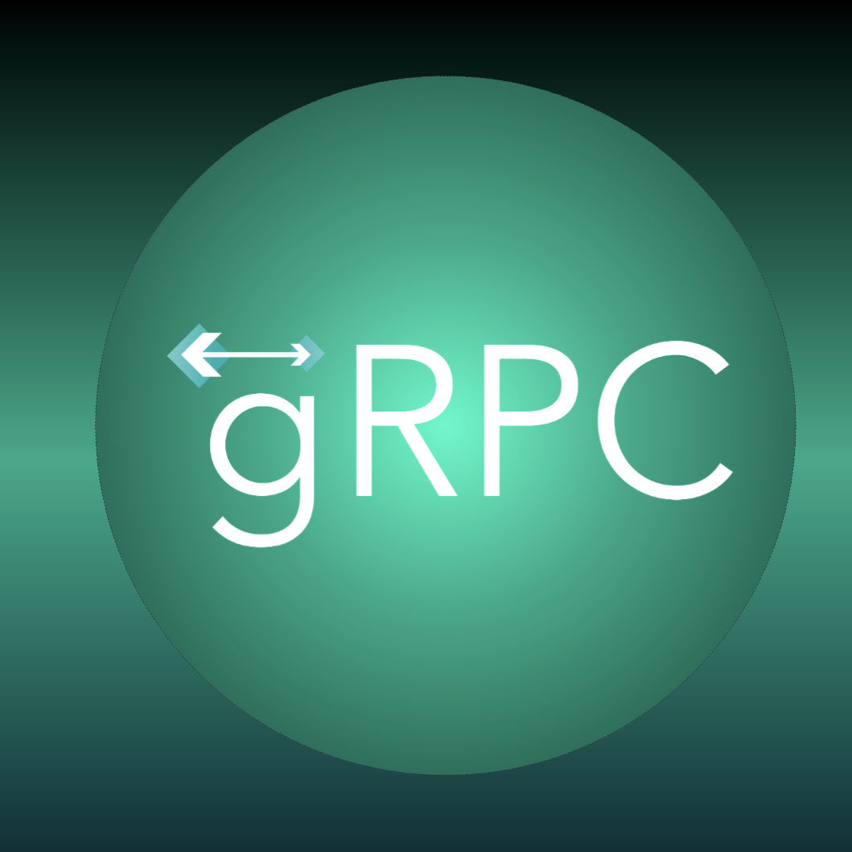
gRPC Framework
by Brijesh Pandey

Slide 2
Content
HTTP/2
gRPC
gRPC web and Proxy
Demo 1
End to End Architecture
End to End Unary Communication
Code walkthrough
Demo 2
Inter server all types of communication
Code walkthrough

Slide 3
HTTP / 2

Slide 4
HTTP/2
Overview
Binary Framing Layer
Streams, Messages, and Frames
Header compression
Stream prioritization
Server push
Flow control

Slide 5
HTTP/2 - Overview
Extends HTTP standards and makes application simples faster and robust.
Goals:
Reduce latency by enabling full request and response multiplexing
Minimize protocol overhead via efficient compression of HTTP header fields
Add support for request prioritization and server push
While the high-level API remains the same, it is important to understand how the low-level changes address the performance limitations of the previous protocols.
Notes:
The application semantics of HTTP are the same, and no changes were made to the offered functionality or core concepts such as HTTP methods, status codes, URIs, and header fields.

Slide 6
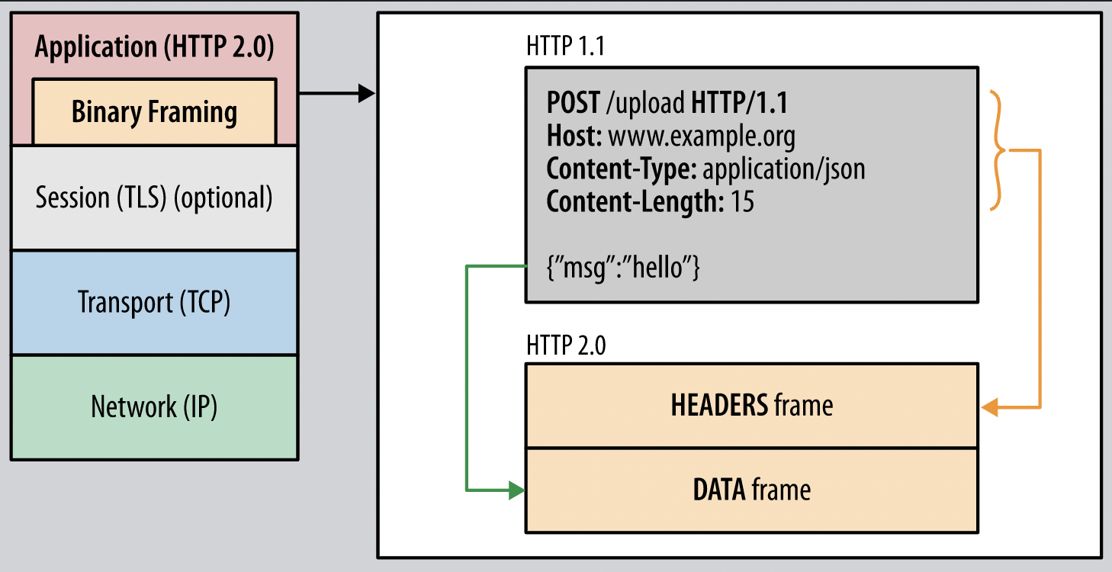
HTTP/2 - Binary Framing Layer
HTTP/2 communication is split into smaller messages and frames, each of which is encoded in binary format.
Both client and server must use the new binary encoding mechanism to understand each other; an HTTP/1.x client won’t understand an HTTP/2 only server

Slide 7
HTTP/2 - Streams, Messages, and Frames
Stream: A bidirectional flow of bytes within an established connection, which may carry one or more messages.
Message: A complete sequence of frames that map to a logical request or response message.
Frame: The smallest unit of communication in HTTP/2, each containing a frame header, which at a minimum identifies the stream to which the frame belongs.
All communication is performed over a single TCP connection that can carry any number of bidirectional streams.
Each stream has a unique identifier and optional priority information that is used to carry bidirectional messages.
Frame carries a specific type of data-e.g., HTTP headers, message payload, and so on. Frames from different streams may be interleaved and then reassembled via the embedded stream identifier in the header of each frame.

Slide 8
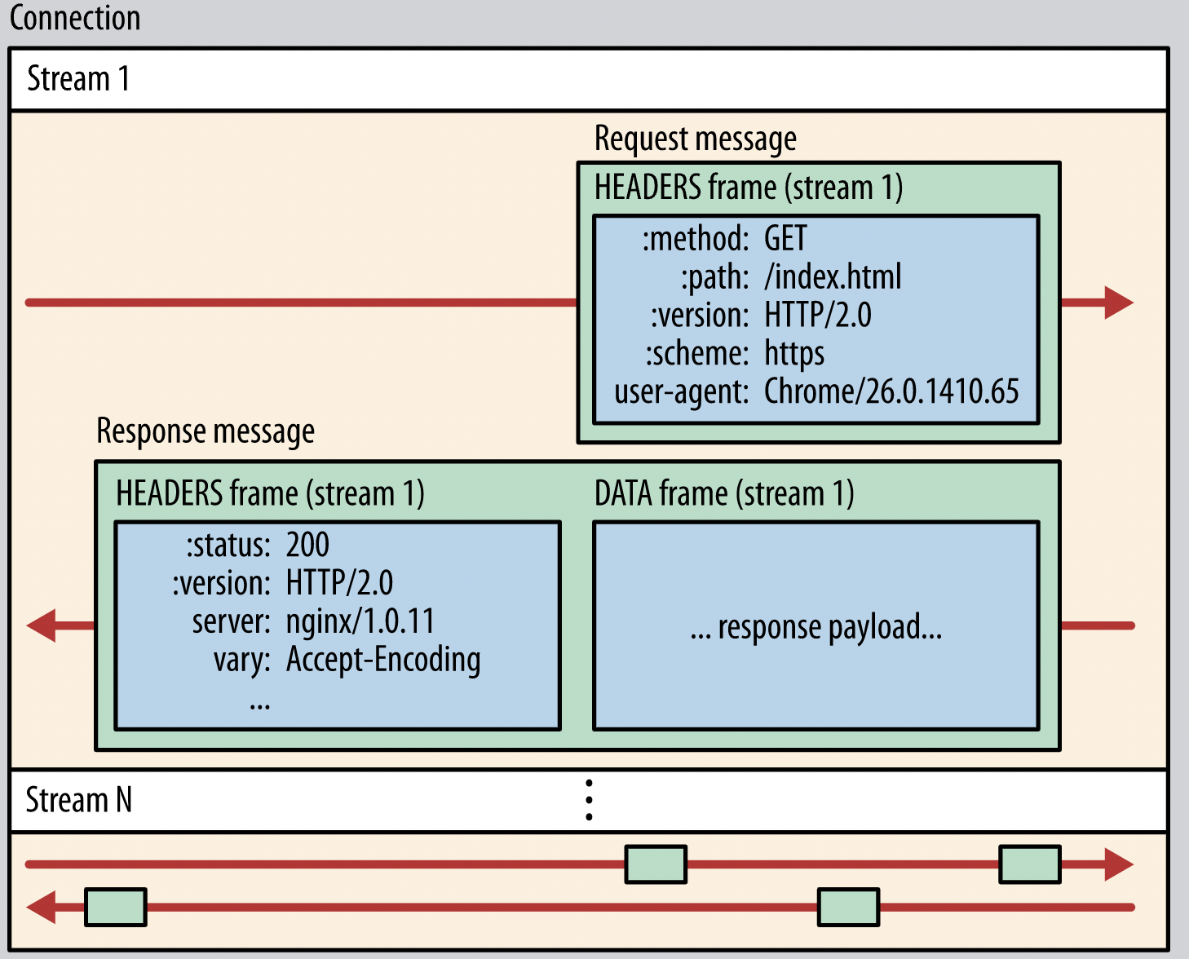
HTTP/2 - Streams, Messages, and Frames

Slide 9
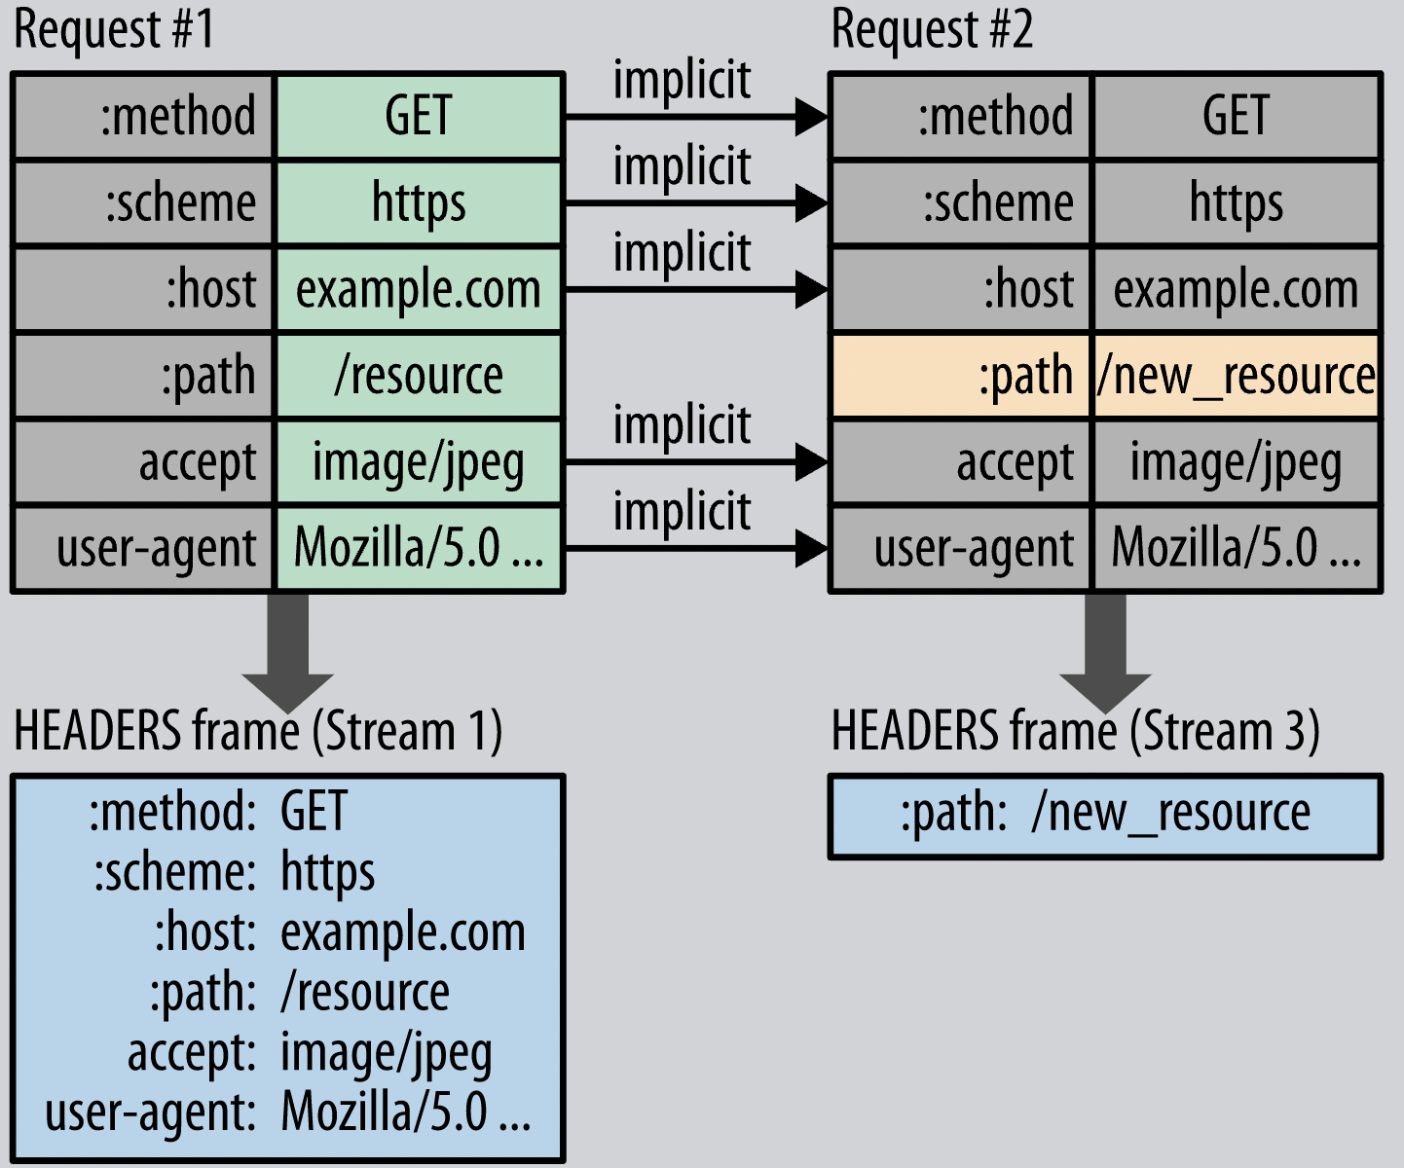
HTTP/2 - Header compression
HTTP/2 compresses request and response header metadata using the HPACK compression format that uses two simple but powerful techniques:
It allows the transmitted header fields to be encoded via a static Huffman code, which reduces their individual transfer size.
It requires that both the client and server maintain and update an indexed list of previously seen header fields, which is then used as a reference to efficiently encode previously transmitted values.

Slide 10
HTTP/2 - Stream prioritization
Each stream to have an associated weight and dependency:
Assigned an integer weight between 1 and 256
Given an explicit dependency on another stream
The server can use this information to prioritize stream processing by controlling the allocation of CPU, memory, and other resources, and once the response data is available, allocation of bandwidth to ensure optimal delivery of high-priority responses to the client.
HTTP/2 protocol also allows the client to update these preferences at any point, which enables further optimizations in the browser. In other words, we can change dependencies and reallocate weights in response to user interaction and other signals.

Slide 11
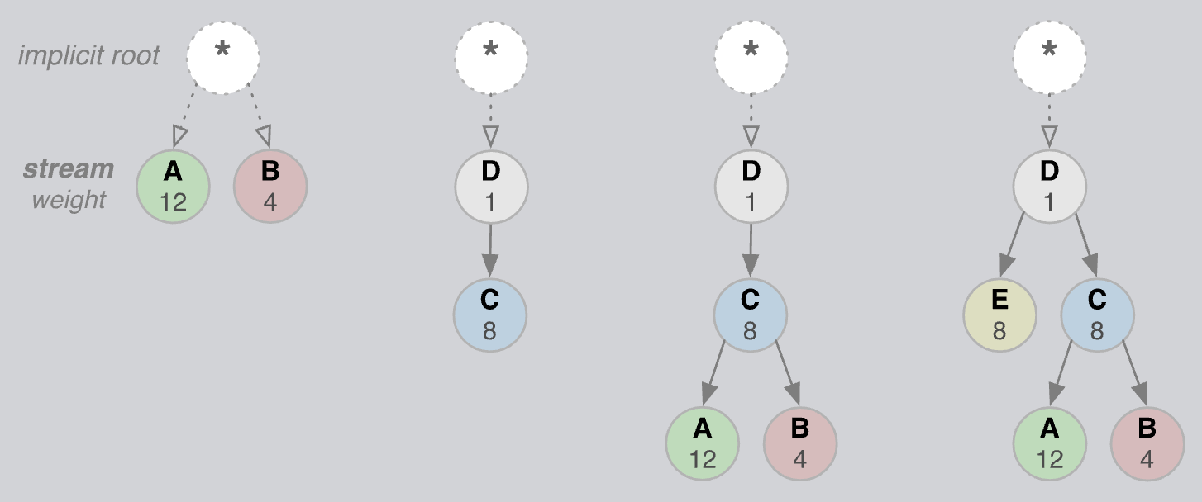
HTTP/2 - Stream prioritization

Slide 12
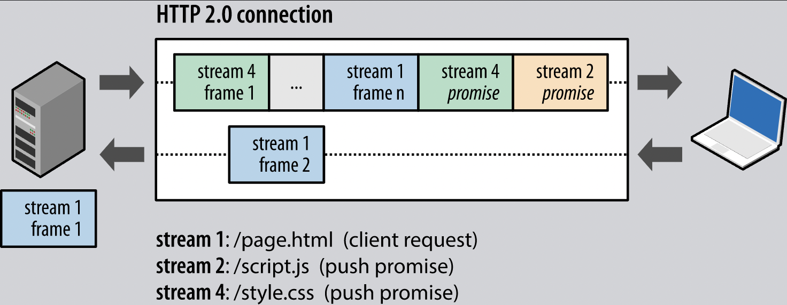
HTTP/2 - Server push
Server can send multiple responses for a single client request, without the client having to request each one explicitly.

Slide 13
HTTP/2 - Flow control
Flow control is a mechanism to prevent the sender from overwhelming the receiver with data it may not want or be able to process; the receiver may be busy, under heavy load, or may only be willing to allocate a fixed amount of resources for a particular stream.
For example, the client may have requested a large video stream with high priority, but the user has paused the video and the client now wants to pause its delivery from the server to avoid fetching and buffering unnecessary data.

Slide 14
gRPC
another Arrow in your Quiver

Slide 15
gRPC
Client can directly call a method on a server, making it easier to create distributed applications and services in polyglot environment
gRPC can use protocol buffers as both its Interface Definition Language (IDL) and as its underlying message interchange format
Written on top of HTTP/2 and thus reduced n/w latency
Google Kubernetes Engine (GKE) provides built-in proxy and load balancing support
Advantages: performance, streaming, stub code generation, interoperability
The use of HTTP/2 over the TLS end-to-end encryption connection in gRPC ensures API security.

Slide 16
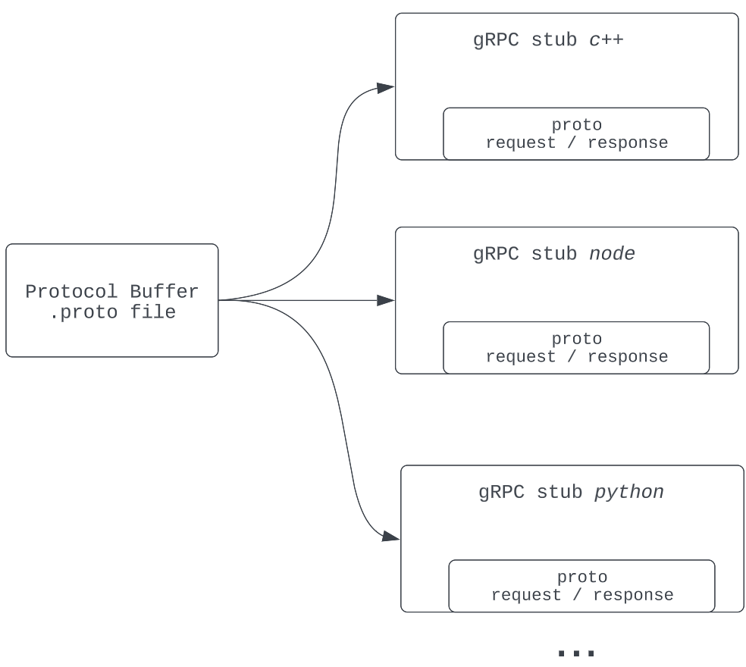
gRPC - Protocol Buffers
Serializing structured data which is language and platform neutral
Generate data access classes in your preferred language(s)
Can generate below combinations of request/response between services:
Unary to Unary communication
Unary to Stream communication
Stream to Unary communication
Stream to Stream communication

Slide 17
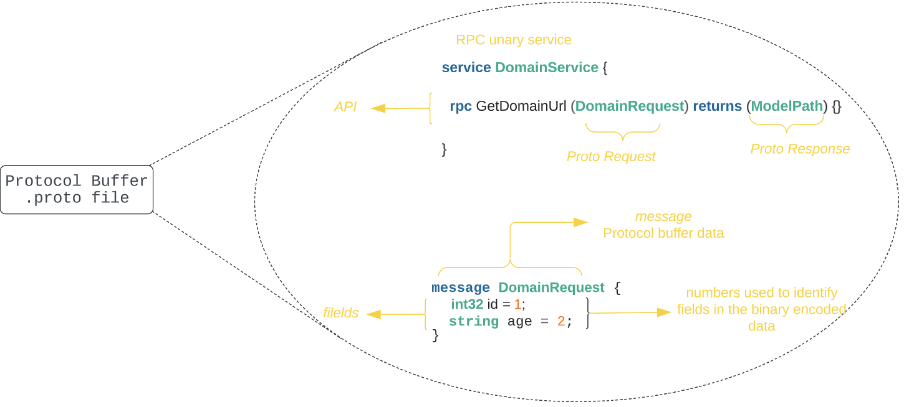
gRPC - Protocol Buffers

Slide 18
gRPC Web and Proxy

Slide 19
gRPC Web and Proxy
gRPC-web is a JS client library enabling application to communicate with gRPC backend server
Data serialization and deserialization logic, wrangling HTTP status codes, managing content type negotiation
Connect to gRPC services via a special proxy which can understands HTTP/1.1 to HTTP/2 requests.
Envoy proxy is a popular choice with grpc-web
UI supports 2 RPC modes:
Unary RPCs
Server-side Streaming RPCs
Client-side and Bi-directional streaming support is under development

Slide 20
gRPC - Disadvantages of gRPC
Limited browser support
Lack of consistent error handling (http://avi.im/grpc-errors/)
Lack of developer tooling
Lack of infrastructure and monitoring support outside of GKE
Lack of caching: gRPC team discussed this issue and working on providing caching support per language.
Lack of support for additional content types

Slide 21
gRPC - Final say
REST has been around for 20 years and gRPC is not a replacement for REST. gRPC APIs can offer huge performance improvements and reduced response time as compared to REST APIs, but which approach to choose boils down to what fits your particular use case.
gRPC is another alternative that could be useful in certain circumstances: large-scale microservices connections, real-time communication, low-power, low-bandwidth systems, and multi-language environments.
Many major companies such as Google, Netflix, Lyft, Square, IBM, Cisco, & Dropbox have adopted gRPC as a means for microservices communication

Slide 22
Demo 1
End to End Unary Communication

Slide 23
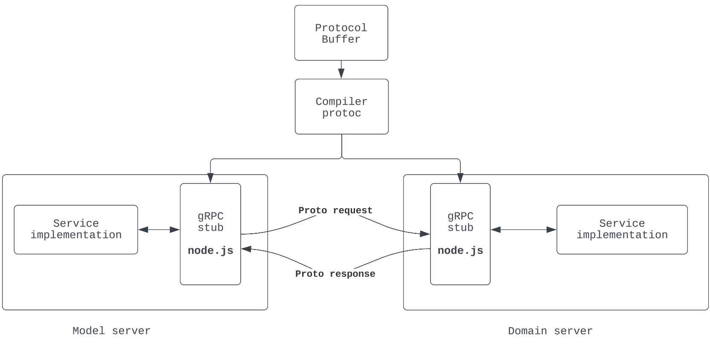
gRPC Demo 1 – BE Architecture
Notes:
https://lucid.app/lucidchart/2f94d0ce-db1d-4b4b-935e-3e85b2b612fd/edit?viewport_loc=142%2C961%2C2289%2C1191%2C0_0&invitationId=inv_7c905028-4699-4e35-86b4-b815f263c5fc

Slide 24
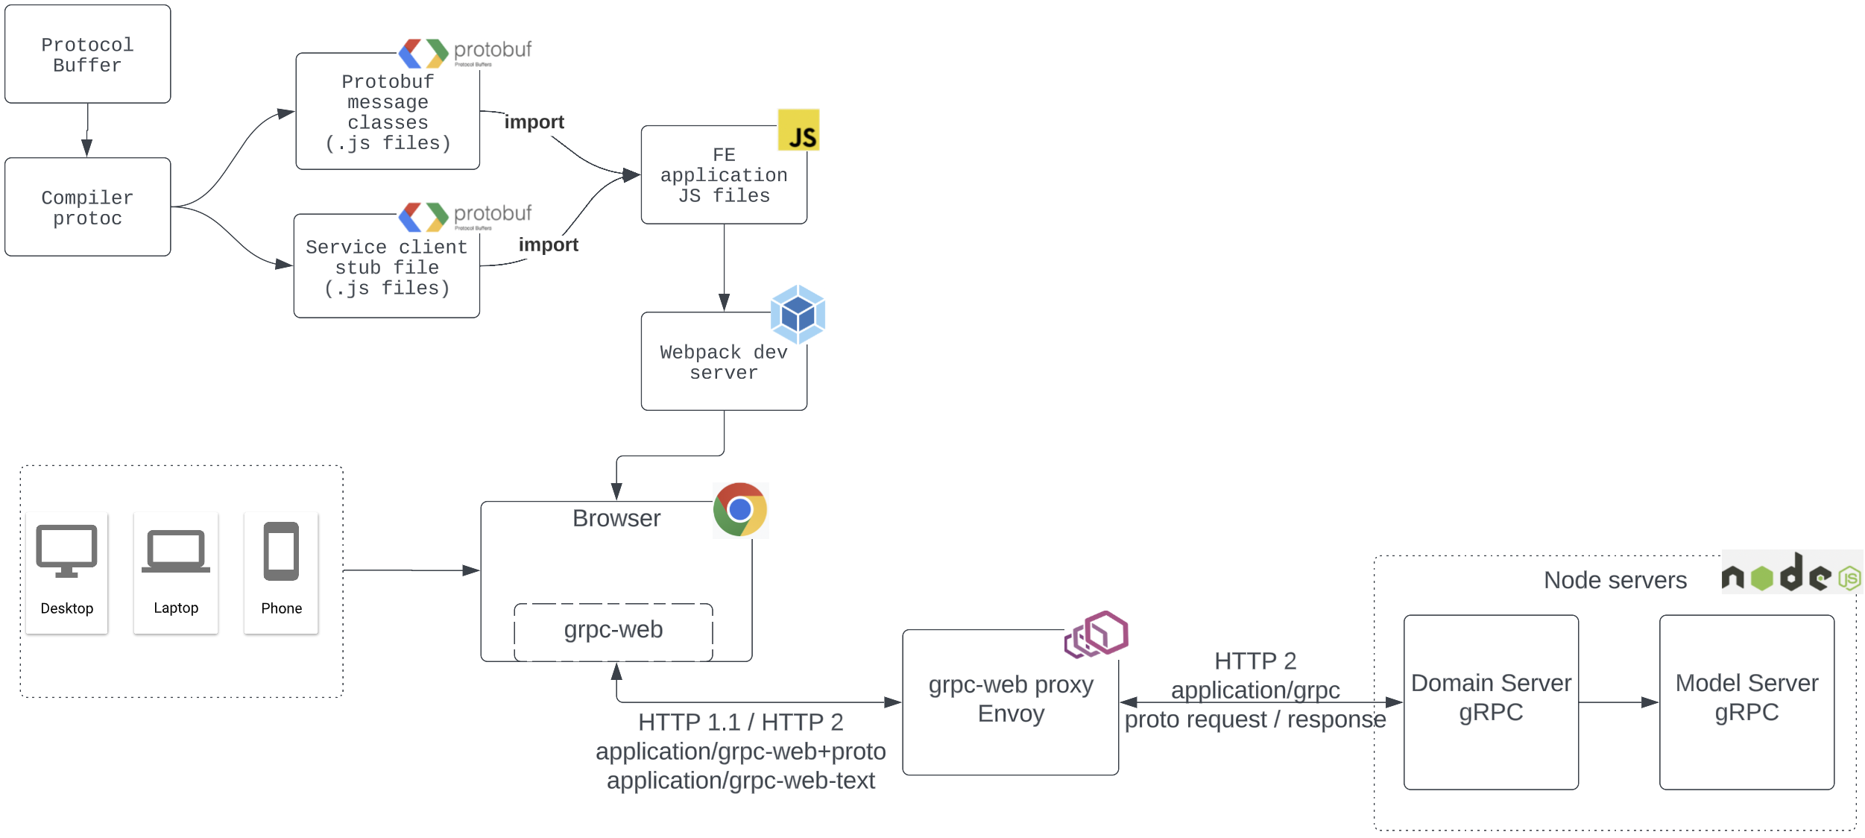
gRPC Demo 1 – Architecture
Notes:
https://lucid.app/lucidchart/2f94d0ce-db1d-4b4b-935e-3e85b2b612fd/edit?viewport_loc=142%2C961%2C2289%2C1191%2C0_0&invitationId=inv_7c905028-4699-4e35-86b4-b815f263c5fc

Slide 25
Demo 1 - Code walkthrough

Slide 26
Demo 2
All types of Server to Server communication

Slide 27
Resources
HTTP/2
gRPC.io
Protocol Buffer
gRPC on .NET
gRPC NodeJS
gRPC ScalaPB
gRPC Web and Proxy quick start
Analyzing gRPC messages using Wireshark
Load balancing in gRPC
Everything in gRPC
Blogs:
Capital One
Wallarm
Digital guide IONOS
Understanding gRPC

Slide 28
Thank you

